Slide 1

Predicting Stroke Risk
Using individual patient data
Scott Breitbach
22-July-2022

Slide 2
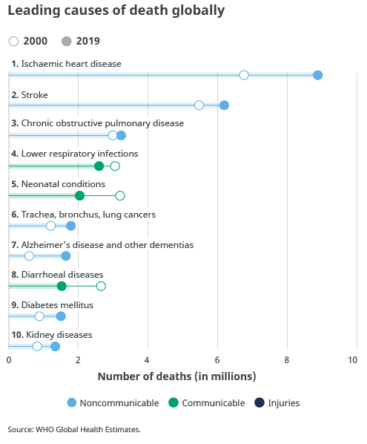
Stroke Statistics
Worldwide
Second leading cause of death
11% of deaths (15 million people)
1 of 6 deaths related to cardiovascular disease
United States
~800,000 annually
Stroke every 40 seconds
Death every 3.5 minutes
https://www.who.int/news-room/fact-sheets/detail/the-top-10-causes-of-death

Slide 3
Stroke Statistics (cont.)
Of ~15 million annual stroke instances:
1/3 result in death
1/3 recover
1/3 are left disabled
A leading cause of long-term disability
Known risk factors:
Cardiovascular/Health:
High blood pressure
High cholesterol
Obesity / diabetes
Age
Other:
Race
Where you live
Notes:
Race: Being black doubles risk; Location: Mortality risk increased in US South

Slide 4
Stroke Dataset: 10 Features
5 Categorical:
2 multiclass
`work_type`, `smoking_status`
2 binary
`ever_married`, `Residence_type`
Converted to 1/0
1 multiclass converted to binary
`gender` (removed ‘Other’)
Converted to 1/0
5 Numeric:
3 continuous
`age`, `avg_glucose_level`, `bmi`
2 discrete, binary
`hypertension`, `heart_disease`
Target Variable:
Binary (1/0)
stroke / no stroke
Extremely imbalanced
Stroke ~2% of dataset
Notes:
Dataset ~43,000 rows

Slide 5
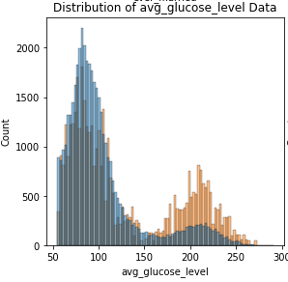
Distributions
Glucose is bimodal
Children at lower risk
~6,000 ‘children’ in dataset
Impacts multiple variables:
`age`
`hypertension`
`heart disease`
`ever_married`
`work_type`
Possibly `smoking_status` (unknown)

Slide 6
Data Preprocessing
Imputing Null values
`smoking_status` 30% Null
Null → ‘Other’
`bmi` ~3% Null
Tried Logistic Regression
Landed on median
Encoding
Binary features → 1 / 0
Multiclass → one-hot encoded
Transformation
Box-Cox – age, bmi, & glucose
Scaled all features -1 to 1
Balancing (~2% stroke)
Oversample stroke
Oversample using SMOTE
Oversample / Undersample
Oversample to 10% of majority using SMOTE
Undersample majority so stroke is 50% of majority
Leave imbalanced and use weights
Notes:
Encoding: Considered 1 vs all for some multiclass (particularly self-employed); Balancing: 98% Accuracy

Slide 7
Model Selection / Evaluation
Metrics:
Hyperparameter Tuning:
Accuracy
98%, predicting no strokes
Recall
Matthews Correlation Coefficient
Area Under Curve (Receiver Operating Characteristic)
Grid Search CV
Random Search CV
Scoring with multiple metrics
Voting Classifier (with weighting)

Slide 8




Conclusions
Huge imbalance, not a perfect model
Need to find a balance in the results
More features could be helpful
Possible inherent bias in the data
Could be high risk but haven’t had a stroke yet

Slide 9
Implementation
Allow people a level of control over their personal healthcare
A healthcare app:
Answer health questionnaire
Store health metrics (weight, blood pressure, health screening results, etc.)
Link activity apps (pulse, steps, etc.)
Predict risk for stroke, heart disease, and others
Provide personalized suggestions for lowering risk
A tool to discuss with your primary care physician

